Slide 1



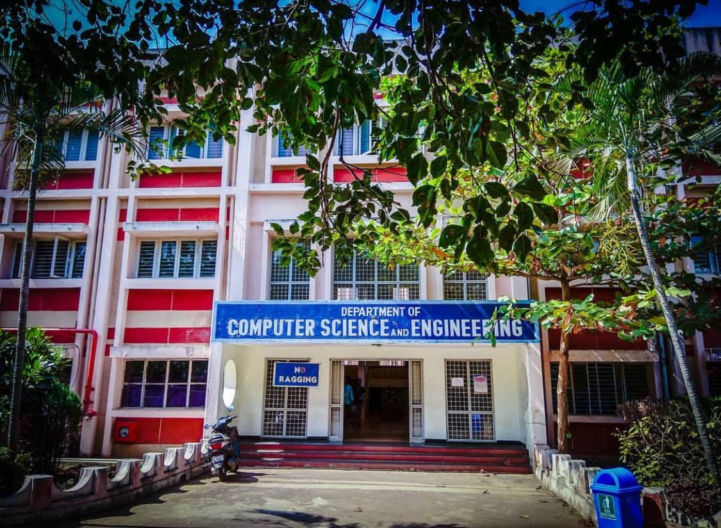
VIRTUAL VOICE ASSISTANT(using python)
Batch
8C
Y. JAYANTHI
21331A05I8
V.V.S CHANDRA MOULI
21331A05I0
P. CHANDU
21331A05D7
V. SAI GANESH
21331A05I4
Supervised by,
<MR. SURYA PRAKASH>
<ASSISTANT PROFESSOR>

Slide 2

1 | Abstract
2 | Introduction
3 | Related Work
4 | Proposed Work
5 | Project Timeline
6 | Implementation & Methodology
7 | Results
8 | Conclusion & Future Work
9 | References
AGENDA

Slide 3
Abstract
Today there is huge Advancement in the Technical field which is increasing day by day. In early days there were only computer systems where we were able to perform only few tasks, but today new technologies like machine learning, artificial intelligence, deep learning, and few some others have made computer systems advance that we can perform any type of task with them. One of the application Area of AI is Natural Language Processing (NLP). Natural Language Processing (NLP) helps Humans to communicate with the computer system in their own Language. For example, Voice Assistant. Various voice assistants were developed and they are still being improved more for better performance to overcome struggling of humans to interact with their machine. we are trying to develop a voice assistant using python which will help user to perform any type of task without interaction with keyboard. The aim of this project is study how voice assistants behaves smartly and can be used to get everyday work done and also be used for educational purpose .

Slide 4
Introduction
The development of a Virtual Assistant for our laptop in a world dominated by technology, having a reliable and personalized assistant can greatly enhance productivity and make everyday tasks more convenient. Our virtual assistant is designed to seamlessly integrate with your laptop, responding to voice commands and providing a range of useful features.
Imagine a world where you can interact with your laptop naturally, where spoken words transform into actionable commands. Our Virtual Assistant harnesses the power of speech recognition (courtesy of the Speech Recognition module) to bridge the gap between you and your device, making interactions more intuitive and efficient . Powered by the Wikipedia API, our assistant doesn't just understand your voice, it's also a knowledgeable companion.
A simple voice command can provide you with a wealth of knowledge, opening up a new dimension of convenience and learning.

Slide 5
Related Work
According to Deepak Shende, Ria Umabiya, the AIVA (Microsoft, Google Assistant from Google, and the recently appeared intelligent assistant under the name "AIVA" 2018) aimed at developing a voice-controlled personal assistant which is doing many things such as to search the Internet. It has some new features like posting comments on the social media websites such as Facebook, Twitter, etc. By just few simple commands. You can also know the weather around you and can get the climate conditions in your region .
Tulshan explained that because of continuous typing there may be possibility of injuries to the fingers of the user. To avoid such problems, we need to design a system in which we can get our work done through our voice commands. The voice will be recognized by the system and that recognized words will be synthesized and if they are appropriate or makes some sense then that will be printed on screen and after this again by recognizing the specific keywords the program will be compiled and executed .

Slide 6
Proposed Work
The system will keep listening for commands and the time for listening is variable which can be changed according to user requirements.
If the system is not able to gather information from the user input it will keep asking again to repeat till the desired number of times.
The system can have both male and female voices according to user requirements.
Features supported in the current version include clicking photos, opening files , shutdown the system by closing all the files and can keep it in sleep mode opening anything in the web browser which are mentioned, and so on are all supported in the present edition.

Slide 7
Project Timeline
Task Performed | Week 1 | Week 2 | Week 3 | Week 4 | Week 5
Setup vs code and python | User requirements | Installing vs code and python | Setting the python interpreter | Creating virtual environment | Python
Modules | Gathering required modules | Installing the modules | Running the power shell as administrator | Importing the modules | Identifying the input constraints
Automation tasks | Code implementation | User-friendly interaction With voice commands | Develop commands for automation | Testing and Evaluation | User Satisfaction

Slide 8
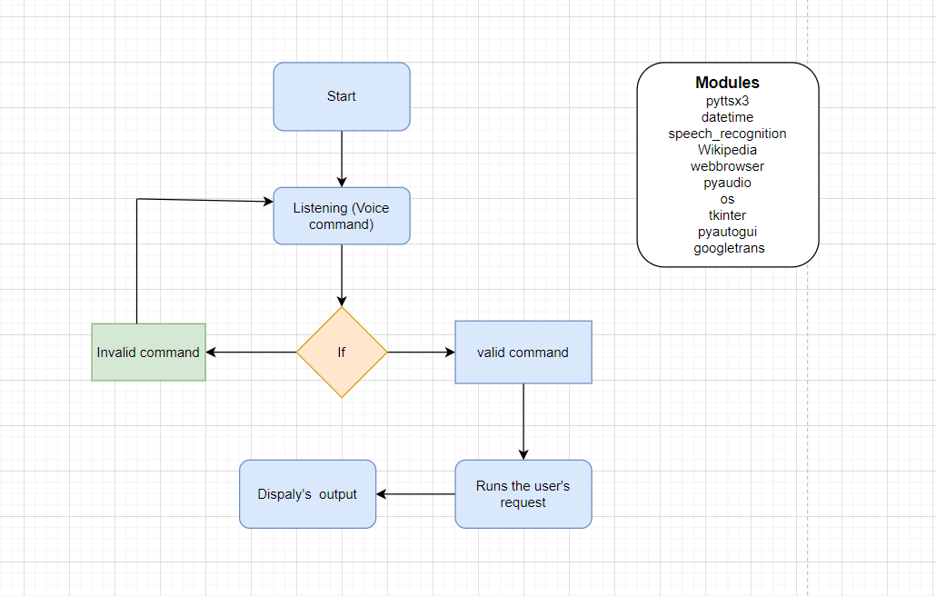
Implementation & Methodology

Slide 9
Implementation & Methodology
The platform versions are as follows:-
Python 3.10.11
Visual Studio Code
Setup Visual Studio Code and Python
Creating virtual environment
Identify the functional requirements of the virtual voice assistant, including supported commands, integration with smart home devices, and user interface design.
Determine the technical requirements such as speech recognition accuracy, natural language understanding, and response time.
Investigate existing virtual assistant systems and relevant technologies.

Slide 10
Implementation & Methodology
Plan the system architecture, including the selection of libraries and frameworks for speech recognition, natural language processing, and home automation integration.
Develop algorithms for intent recognition and command parsing based on user input.
Implement natural language understanding capabilities to interpret user queries and commands accurately.
Integrate speech recognition for voice command input and text-to-speech conversion for audio feedback.
Testing the assistant by providing the voice commands to meet the user requirements.

Slide 11



Results
Results
The results of this virtual assistant are various things
It tells us the time when we ask for it (24-hour time format)
It navigates through various websites on the user’s request
It sleeps when we say so
It shutdown the system when we say so
And so on…
Some of the outputs are placed in following slides

Slide 12
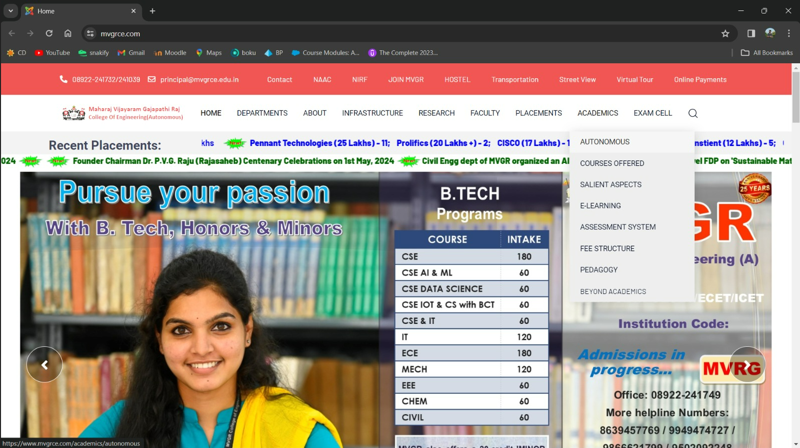
This is the output when I asked for the assistant to open the college website

Slide 13
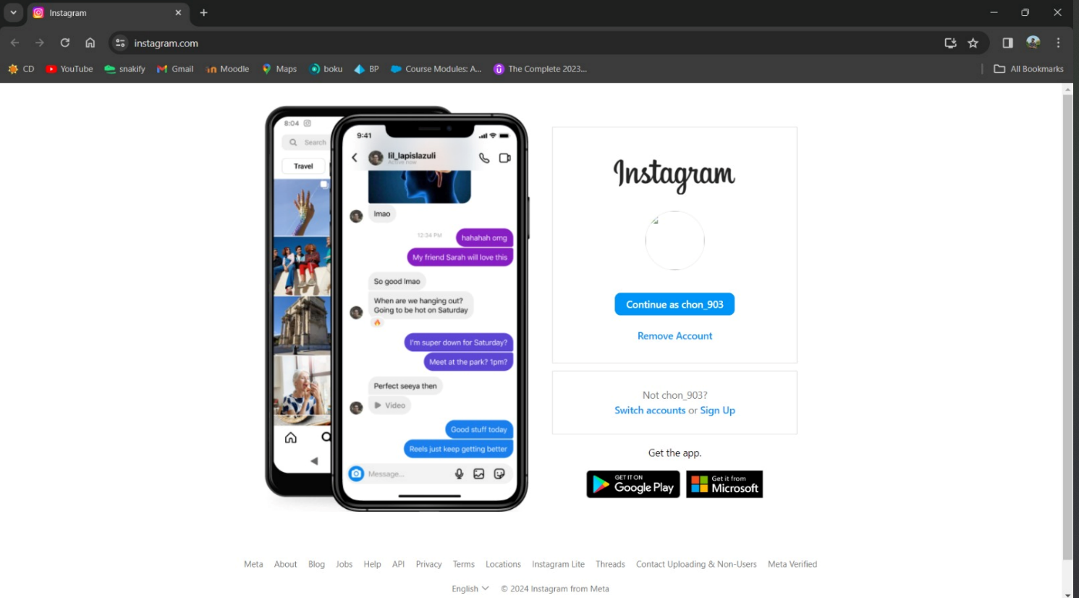
This is the output when I asked the assistant to open Instagram

Slide 14
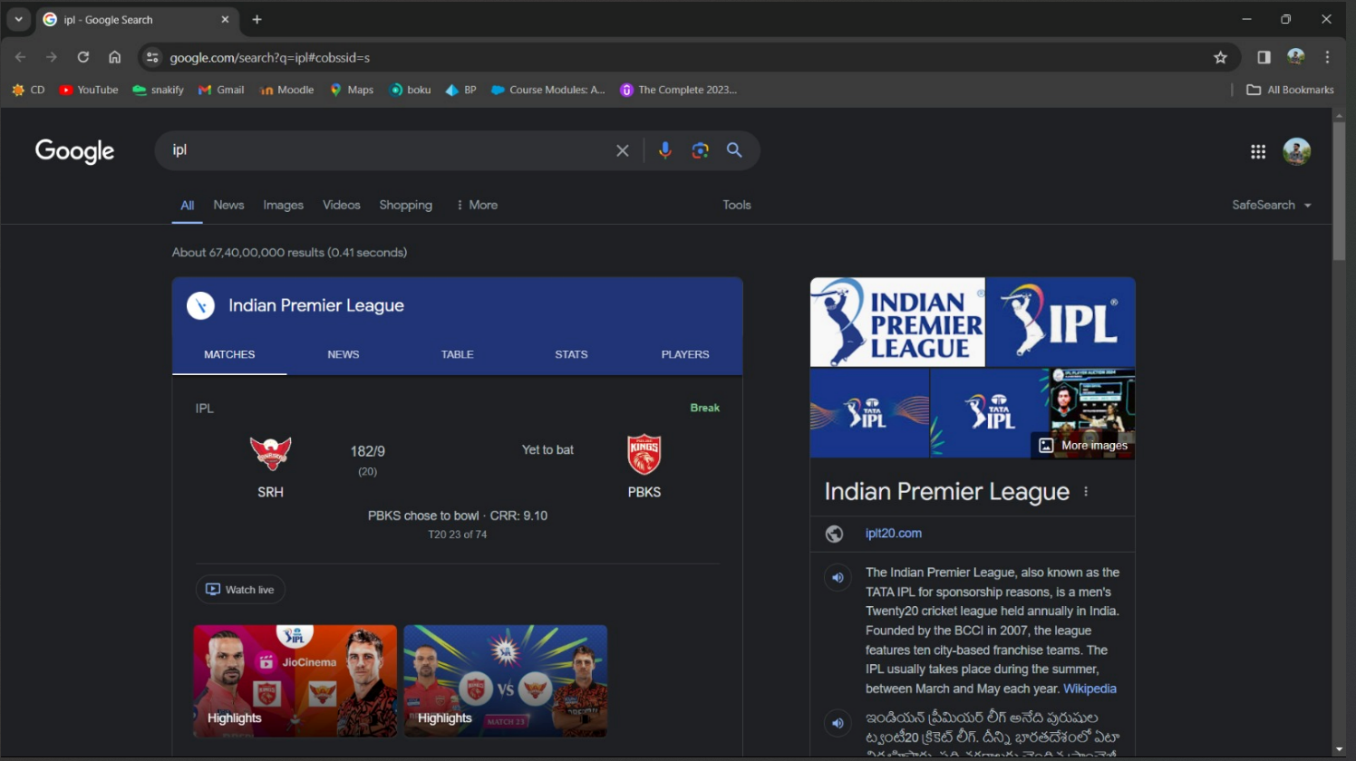
This is the output when I asked the assistant to search for the ipl

Slide 15

Conclusion & Future Work
Laptop based voice assistant using Python which is built using open-source software VScode as an implementation tool. This Project will be helpful for people of all generations as well as to people with some disabilities or people with some special cases. The personal voice assistant will be easy to use and will reduce the manual human efforts for performing various tasks.
The functionality of the current voice assistant system is limited to working on Desktop based and working online (required to have internet connection to perform tasks) only. The voice assistant system is modular in nature so that addition of new features is possible without disturbing current system functionalities.

Slide 16
References
[1] Jain, Raj Kumar, et al. "Artificial Intelligence Based A Communicative Virtual Voice Assistant Using Python & Visual Code Technology." World Journal of Research and Review (WJRR) 13.5 (2021): 23-26.
[2] Appalaraju, Vadaboyina, et al. "Design and development of intelligent voice personal assistant using python." 2021 3rd International Conference on Advances in Computing, Communication Control and Networking (ICAC3N).
[3] Fapal, A., Kanade, T., Janrao, B., Kamble, M., & Raule, M. (2021). Personal Virtual Assistant for Windows Using Python. International Research Journal of Modernization in Engineering, 3(07), 485-491.
[4] Kannake, Rashmi, Pranmya Kale, Nikhil Dongre, Vipul Kshirsagar, and Yogesh Tajane. "SMART VIRTUAL VOICE ASSISTANT USING PYTHON."

Slide 17

Abstract | Introduction
Related Work | Proposed Work
Implementation & Methodlogy | Results
Conclusion & Future Work | Any Queries?
SUMMARY
12

Slide 18
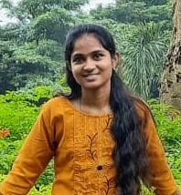
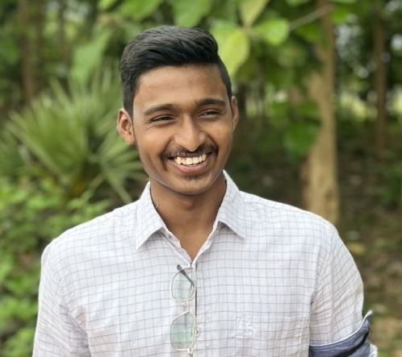
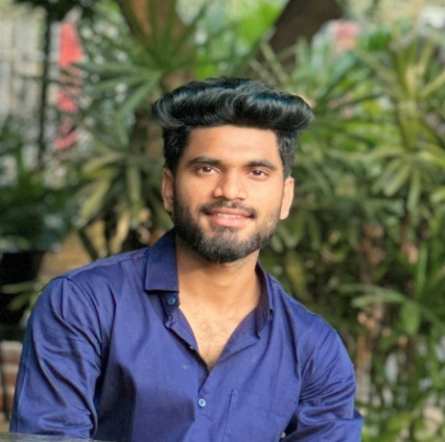
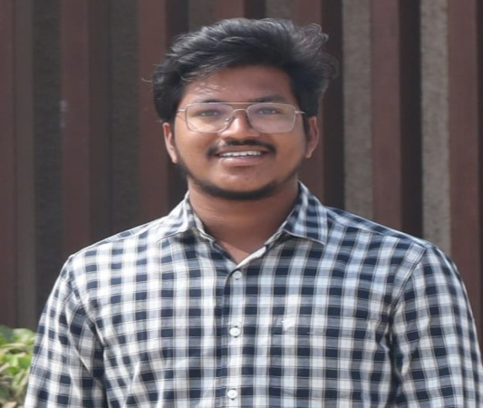
Our Team
Y.JAYANTHI
V.V.S CHANDRA MOULI
P. CHANDU
V. SAI GANESH

Slide 19
Acknowledgements
We would sincerely like to thank Mr. Surya Prakash Sir for the support and enriching our knowledge in technologies outside our domain and providing an insight for the project. Your continued expertise and guidance along with an insightful feedback made this possible.
Additionally, we extend our thanks to Prof. P.S. Sitharama Raju (Director), Prof. Ramakrishnan Ramesh (Principal), and Dr. T. Pavan Kumar (Head of the Department) for their unwavering support and assistance, which were instrumental in the successful completion of the project.

Slide 20
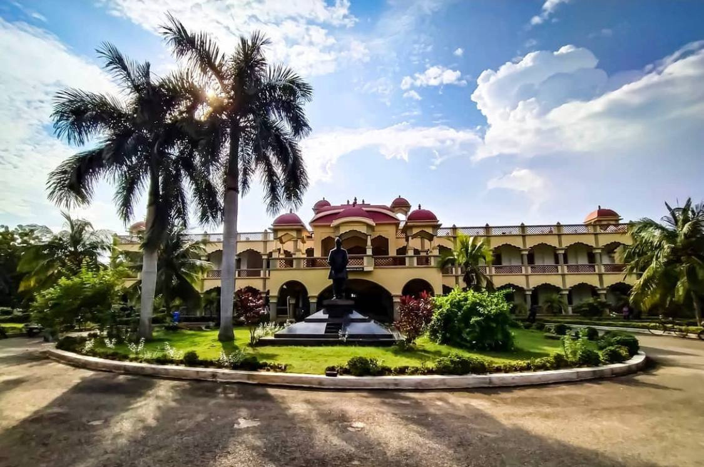

Thank You!

